Slide 1
Ecommerce Project
Enhancements for Add to Cart Functionality

Slide 2

Introduction
This presentation focuses on enhancing the 'Add to Cart' feature in our ecommerce project. We will explore user interactions and backend integration, essential for improving user experience and operational efficiency.

Slide 3
01
Add to Cart

Slide 4
User Interaction
User interaction with the 'Add to Cart' feature is crucial for conversions. Key components include intuitive buttons, feedback mechanisms, and accessibility features. Testing different designs and placements can significantly impact user behavior. Usability studies help understand preferences and optimize the experience for various devices.

Slide 5
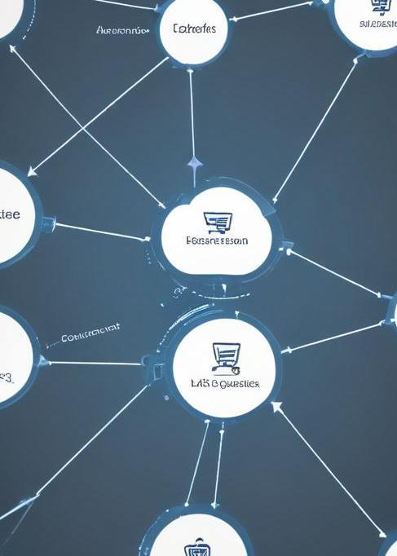
Backend Integration
Effective backend integration supports the 'Add to Cart' functionality by managing inventory, processing user selections, and ensuring data accuracy. This involves API connections to inventory systems, user session management, and secure payment processing. Implementing a robust architecture minimizes errors and enhances user confidence.

Slide 6
Data Storage
Effective data storage is essential for managing 'Add to Cart' functionalities. This includes the choice between cloud storage and on-premises solutions, ensuring data consistency and availability. Techniques like session storage and database management systems (DBMS) are utilized for keeping track of user selections and preferences. Security measures, such as encryption and access controls, safeguard sensitive user data and transaction details, thus enhancing trust and reliability within the ecommerce platform.

Slide 7
02
Continuation Strategies

Slide 8

User Engagement Techniques
To enhance user engagement after adding items to the cart, techniques such as personalized recommendations, email notifications, and loyalty programs can be employed. Engaging users through interactive elements, such as quizzes or surveys about their preferences, can lead to a deeper connection with the brand. Additionally, utilizing social proof, like customer reviews, can foster a sense of community and encourage further interaction with the site.

Slide 9
Cross-selling Opportunities
Cross-selling opportunities present significant potential for increasing average order value. By analyzing user behavior and purchase history, targeted product suggestions can be displayed alongside items in the cart. Implementing effective algorithms for product pairings and bundling strategies can create a compelling shopping experience, enticing users to add additional items to their cart before checkout.

Slide 10
Abandonment Recovery
Abandonment recovery strategies are critical for converting lost sales. Tactics include sending reminder emails with enticing subject lines, offering discounts or promotions, and providing easy navigation back to the user's cart. Additionally, understanding the reasons behind cart abandonment through analytics can inform better UX practices and reduce friction in the checkout process, enhancing overall conversion rates.

Slide 11

Conclusions
Integrating robust strategies for the 'Add to Cart' experience and subsequent user engagement can significantly enhance ecommerce performance. By focusing on effective data management, user interaction, and recovery techniques, we can ensure greater customer satisfaction and increased sales.

